Slide 1

Crime, City Services, and Resident Satisfaction in Nashville (2016 - 2018)
Ed Brown
Nashville Software School
Data Analytics Cohort 9

Slide 2
Agenda
01
02
03
Introduction
Data Used and Methodology
MNPD Incidents
04
05
06
hubNashville Requests
Conclusions and Recommendations
Dashboard Demonstration
Summary of the project and goals
Overview of the datasets and how they were used
Overview of most impacted areas in Nashville
Analysis of requests submitted to hubNashville
What comes next
Explore the Nashville neighborhoods that interest you

Slide 3

Introduction
01

Slide 4

Data Questions
What areas of Nashville are most impacted by crime?
Are the residents in those areas more dissatisfied with crime and police than other areas?
Does living in a high-crime areas skew residents’ perceptions of other city services, as well?
Can anything be done to improve conditions?

Slide 5

Why This project?
Worked for Metro since July 2019
Crime and its impact on an area of personal of interest
Leverage skills I’ve developed in this course

Slide 6

02
Data Used and Methodology

Slide 7

Data Used
MNPD Incidents
Metro Resident Survey Responses
hubNashville (311) Service Requests
All data is open data available through the data.nashville.gov portal and does not contain PID or sensitive information
Database of incidents that Metro Nashville Police have responded to, with supporting info
Responses by Metro residents about crime, quality of life, trash services, and other areas
Requests for service for things like street maintenance, trash removal, etc.

Slide 8
Methodology
Determine the 10 areas most impacted by crime using MNPD Incidents, analyze responses on crime using Resident Survey, then examine service requests and service satisfaction using hubNashville Requests.
Data Manipulation
Removed ZIP Codes that fall outside of Davidson County
Dropped any rows where the ZIP code wasn’t known/blank
Only kept incidents where police could take conclusive action (i.e. no false reports, refusal to prosecute, etc.)
Removed ZIP Codes from survey with less than 10 responses
Combined Very Dissatisfied, Dissatisfied, and Neutral responses to survey into one categories
Limitations/Considerations
Survey data concluded in 2018
Survey responses skewed to about 15 ZIP codes and roughly 2,000 responses (less than 1% of the population at that time)
Limited ability to gauge “accuracy” of survey responses

Slide 9

03
MNPD Incidents

Slide 10
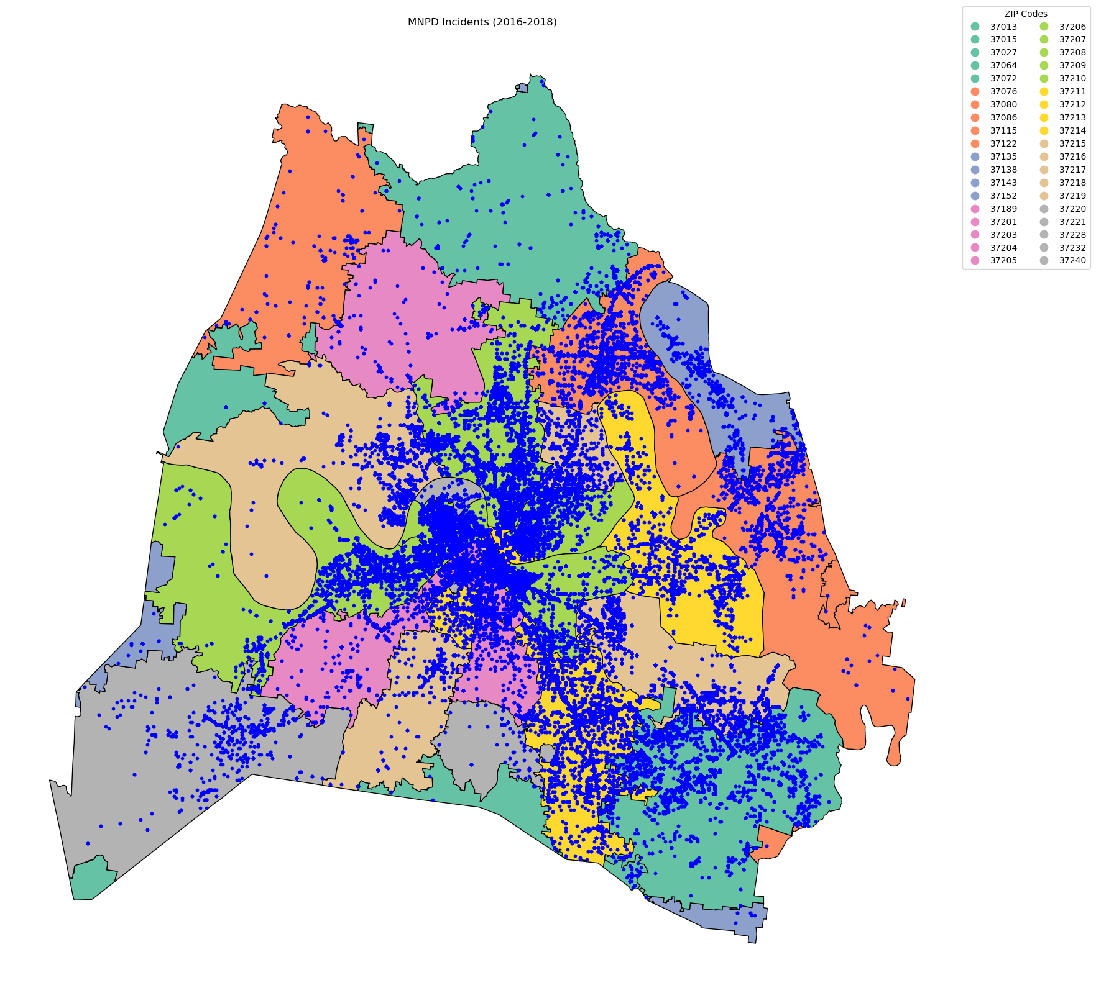

Slide 11
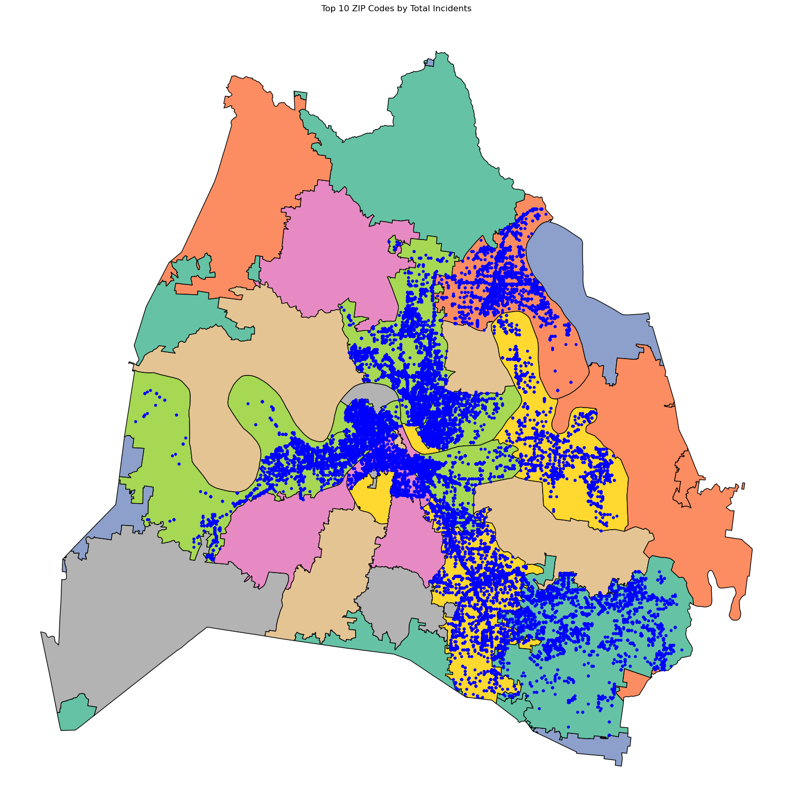
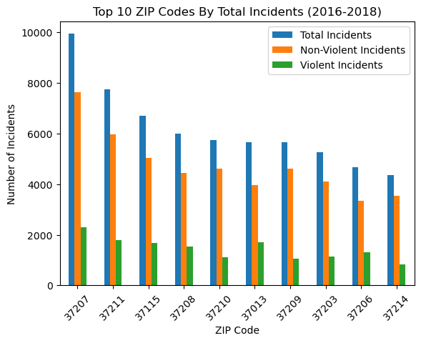

Slide 12
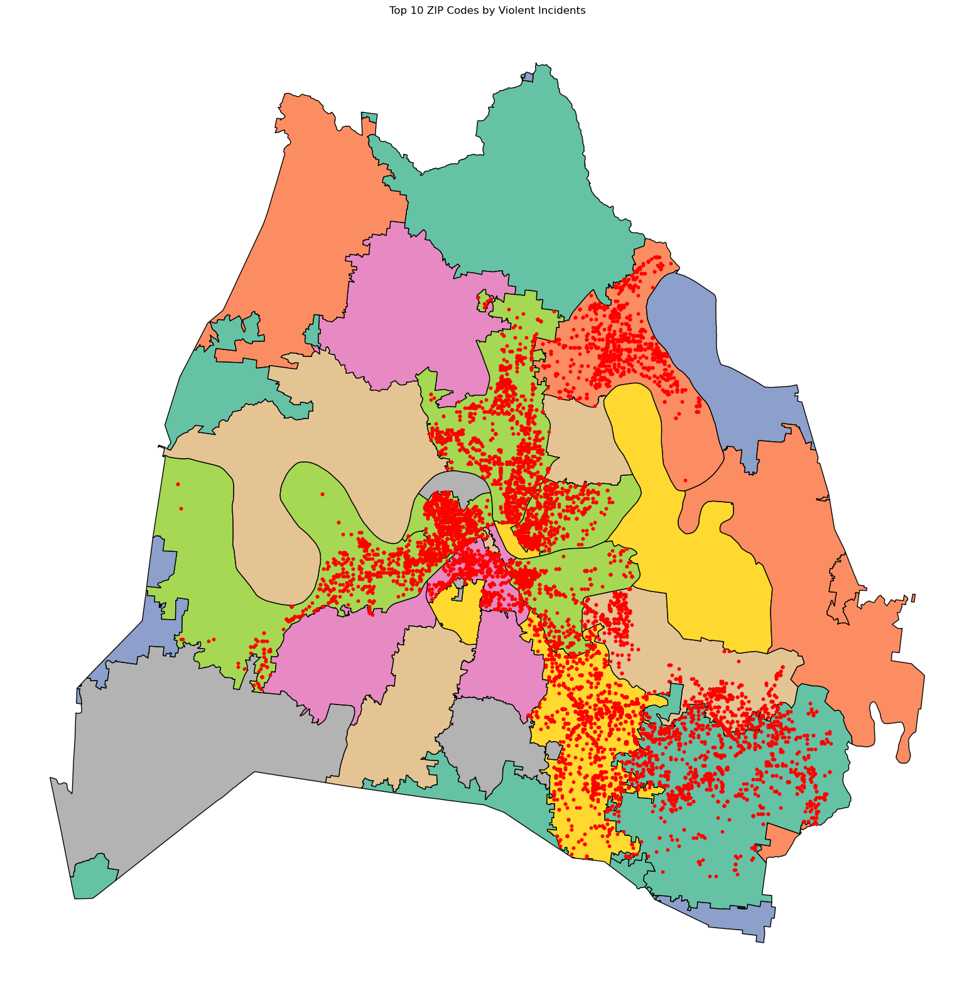
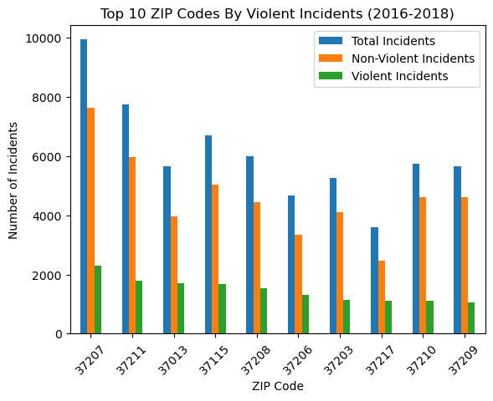

Slide 13
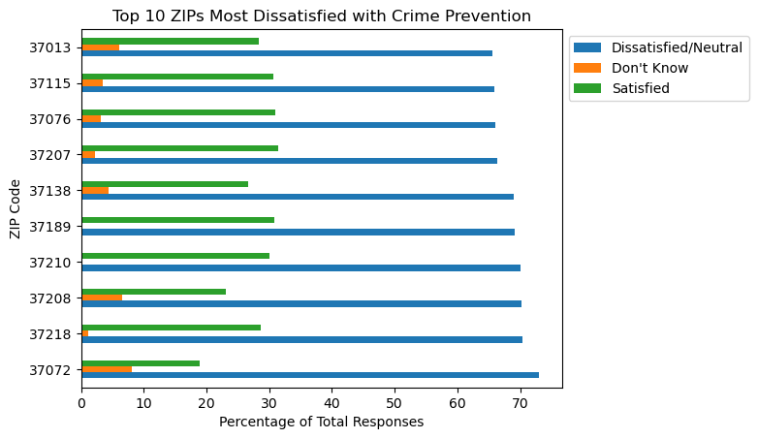
Interesting Correlations
In analyzing the Top 10 ZIPs most dissatisfied with crime, we find that only 5 of them are in the worst areas for crime …

Slide 14
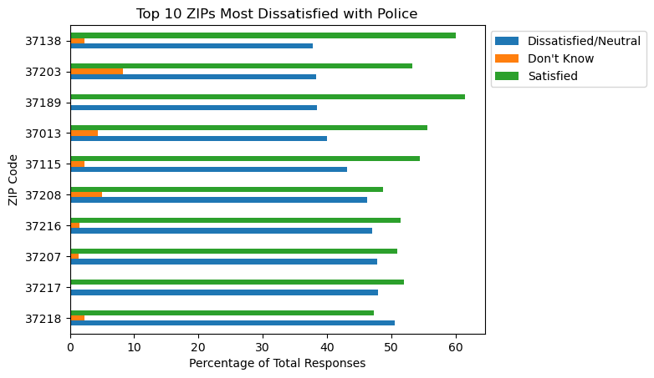
Interesting Correlations
… while only 5 are for those most dissatisfied with police, as well.

Slide 15

hubNashville Requests
04

Slide 16
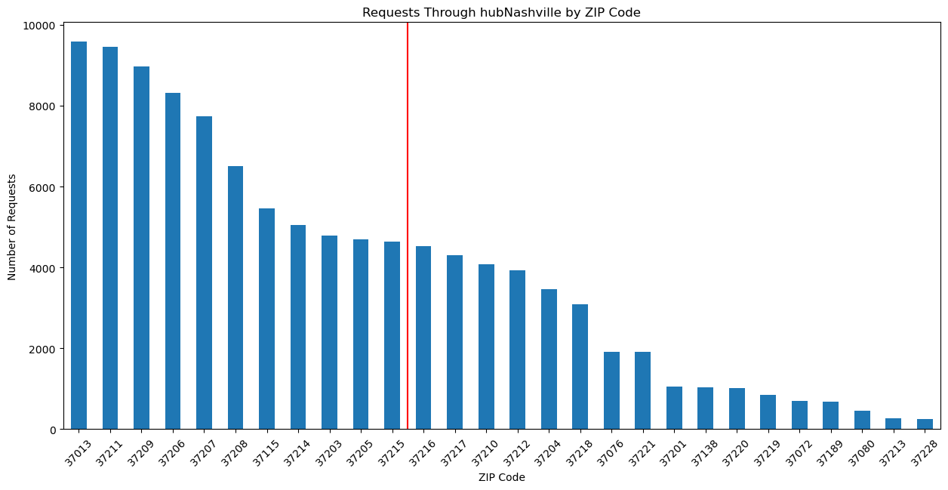
Of the 10 ZIP codes with the most requests, 7 are also in the worst areas for crime

Slide 17
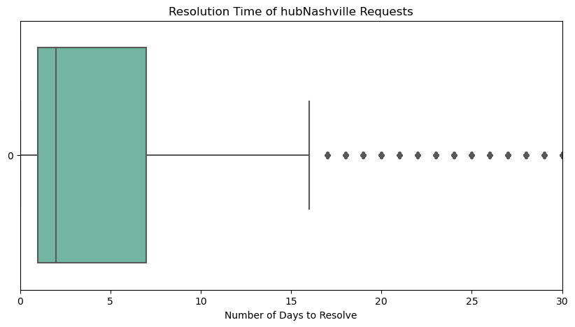
Metro was Quick to Respond …
Of the 108,985 requests analyzed, it took anywhere from 1 to 2171 days to resolve
However, 75% of all requests were resolved within 7 days

Slide 18
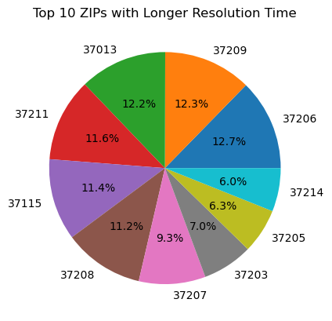
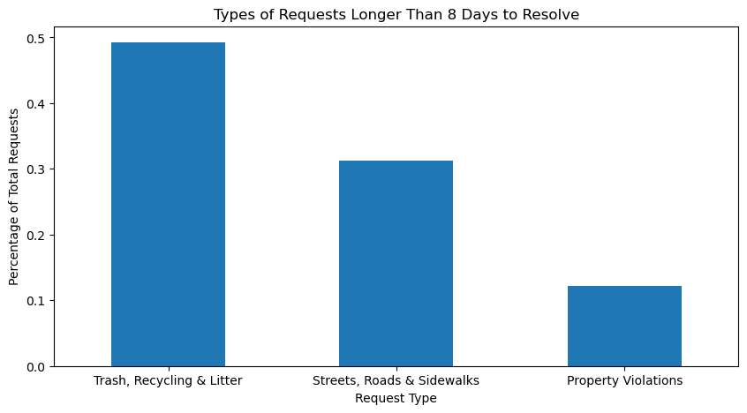
… But There Were Still Some Common Problem Areas
Among the Top 10 ZIP Codes where service requests took more than 8 days to resolve, 8 were also in the worst areas for crime

Slide 19
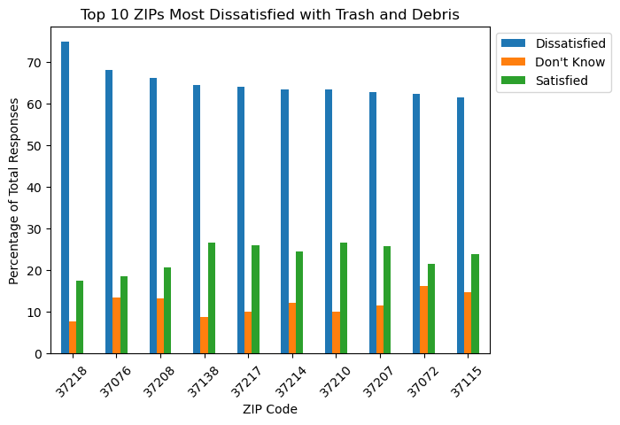
Severe Offsets in Expectations
Among the ZIP Codes most dissatisfied with Trash and Debris, only 4 of them were in the Top 10 ZIP codes for longer resolution times …

Slide 20
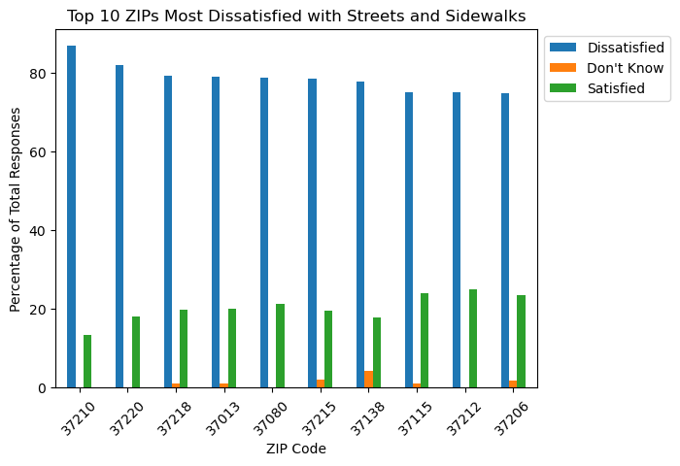
Cont’d.
… while just 3 of those dissatisfied with Streets and Sidewalks were …

Slide 21
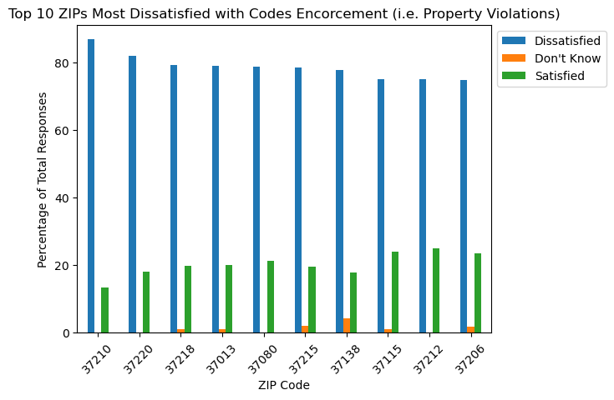
Cont’d.
… and 3 final ones in those most dissatisfied with Codes Enforcement

Slide 22

05
Conclusions
and Recommendations

Slide 23
Conclusions
1) Not Always a Strong Correlation
Between High Crime/Speed of Service and Resident Satisfaction
2) There Was a High Correlation in Four ZIP Codes
3) More Data Needed to Substantiate Resident Survey Claims
37013 - Antioch
37115 - Madison
37207 - Brooklyn Heights
37208 - North Nashville/Germantown

Slide 24
Recommendations
1) Conduct a New Resident Satisfaction Survey
2) Focus Improvement Efforts on the Four Identified ZIP Codes
3) Expand Data Collected for MNPD Incidents and hubNashville Requests to Validate Survey Responses
Stronger Crime Prevention Efforts
Quicker resolutions to Trash, Streets, and Property Requests

Slide 25
Dashboard Demonstration
06

Slide 26

Special Thanks
AJ Grande
Chase Taylor
Dibran Rexhepi
Olariche “Ola” Obi
Alex Wright
Sobiya Uddin
Members of NSS DA Cohort 09 The Staff of Nashville Software School
Questions

